Slide 1



Vision Language Models & PaliGemma
Nitin Tiwari
Google Developer Expert – Machine Learning Associate Data Scientist @ Colgate-Palmolive

Slide 2
$whoami
Associate Data Scientist at Colgate-Palmolive India Ltd.
Google Developer Expert in Machine Learning
Contributor to Gemma Cookbook, TensorFlow.js, Google Dev Library
Technical Speaker (50+ talks across India and internationally)
Write blogs on AI/ML on Medium

Slide 3
Content
Introduction to Vision Language Models
Architecture of a typical VLM
What is PaliGemma?
Examples of PaliGemma
PaliGemma 2: What’s new?
Resources for you to get started

Slide 4
Vision Language Models

Slide 5
Vision Language Models
Vision Language Models are multimodal models that learn from images and text, generating text outputs from image and text inputs.
They excel in zero-shot capabilities, generalization, and various tasks like image recognition, question answering, and document understanding.
These models can also capture spatial properties and output bounding boxes or segmentation masks for specific subjects.

Slide 6
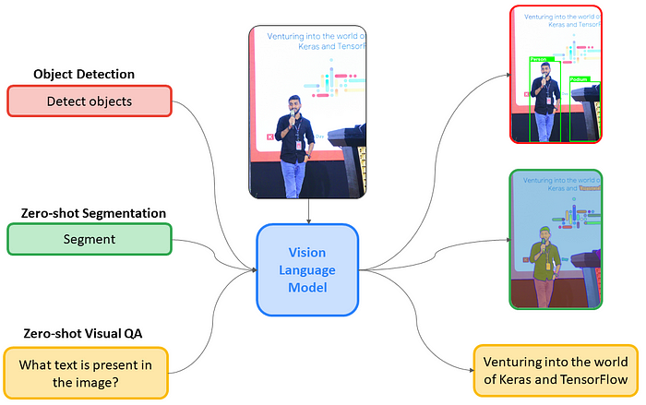
Vision Language Models

Slide 7

Architecture of a typical VLM
Text Output
Text Decoder
Text Decoder
Projected visual tokens + text embedded tokens
Multimodal Projector
Text Prompt
Image Encoder
Multimodal Projector
Text Prompt
{CLIP, SigLIP, etc.}
Frozen (not trainable)
Not frozen

Slide 8
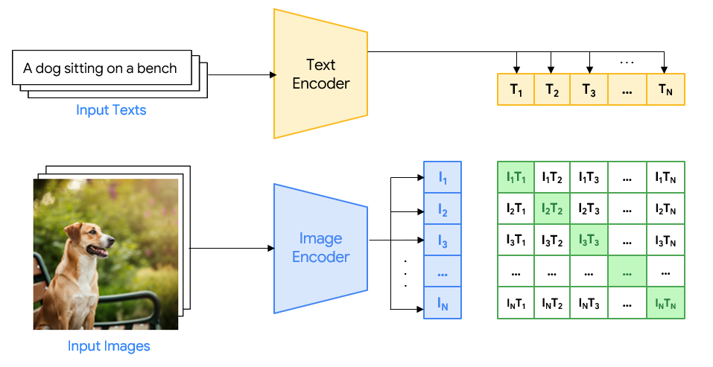
Example: Contrastive Pre-training

Slide 9
PaliGemma

Slide 10
PaliGemma
PaliGemma is an open Vision Language Model from Google with just 3B parameters designed to perform a variety of tasks such as image captioning, object detection, image segmentation, visual question & answering, optical character recognition, and more.
Inspired by PaLI-3, PaliGemma uses SigLIP (Sigmoid Loss for Language Image Pre-Training) as the image decoder and Gemma 2B as the underlying language model.
I’ll handle the vision capabilities
I’ll handle the text part
SigLIP (image encoder)
+
Gemma 2B (text decoder)
=

Slide 11
PaliGemma
PaliGemma is available in different variants:
Pre-trained model: The general purpose base model trained for a variety of tasks.
Fine-tuned model: Customized/fine-tuned for doing specific tasks.
Mixed model: A mixture of PT and FT PaliGemma models.
PaliGemma comes in 3 resolutions – 224x224, 448x448 and 896x896.
But… when do we need a fine-tuned model? 🤔

Slide 12
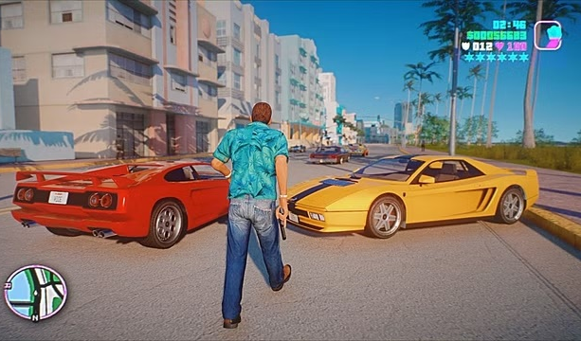
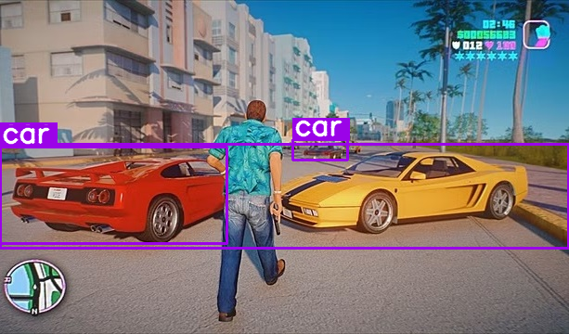

When do we need to fine-tune?
Prompt: Detect car Output
Pre-trained models are suited best for general purpose tasks. As long as the pre-trained model works well, there’s no need to fine-tune it.

Slide 13
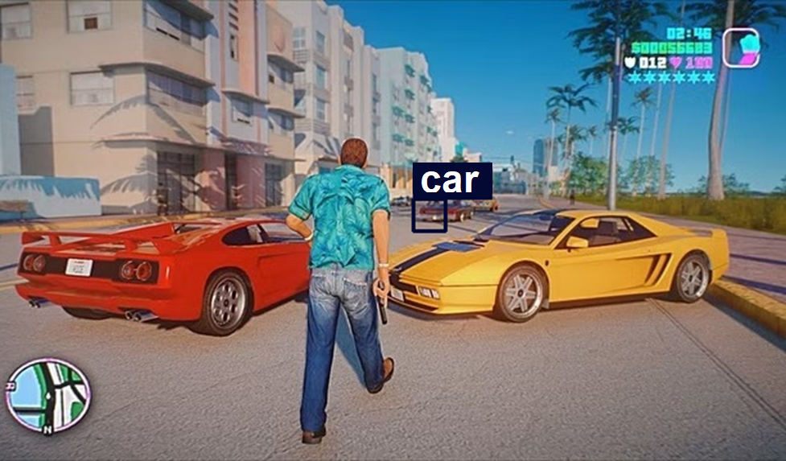

When do we need to fine-tune?
Prompt: Detect red car Output
Pre-trained model has failed to detect red cars specifically. So, we need to fine-tune it for this specific task.

Slide 14
Examples of PaliGemma * All the images/videos used are real, and tested without editing. *

Slide 15
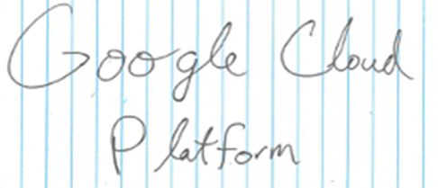
Visual Question & Answering
Given an image, PaliGemma can answer questions based on it.
Prompt: What is present in this image?
Response: Google Cloud Platform

Slide 16
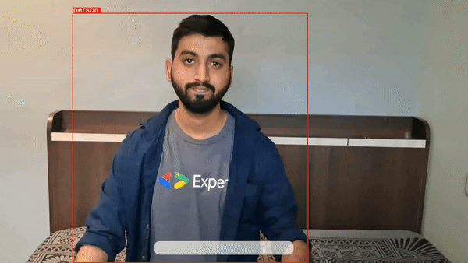
Zero-shot Object Detection
PaliGemma is capable of zero-shot object detection, meaning, without training the model on specific datasets, it can detect objects with just a text prompt.

Slide 17
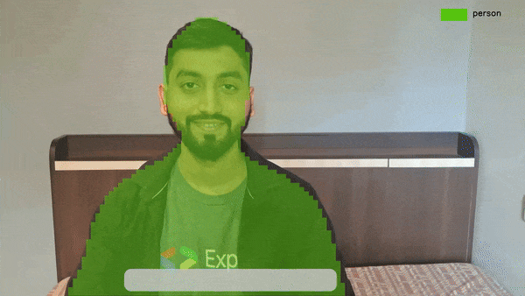
Instance Segmentation
PaliGemma can also segment objects in images and videos merely using a text prompt.

Slide 18
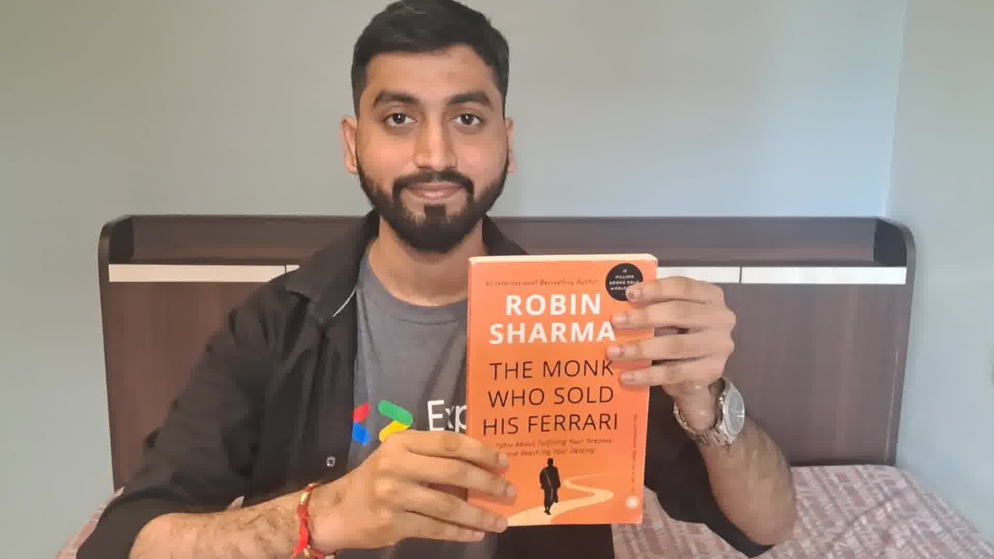
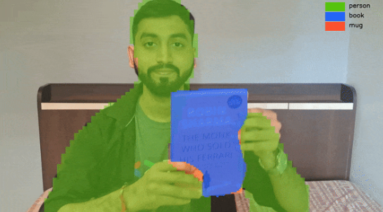
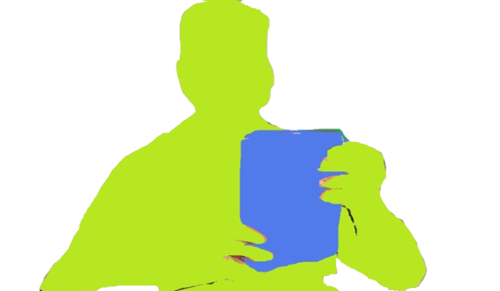
How does it work?
Text Prompt: Segment person, mug, book
<loc100><loc200><loc300><loc400><seg058><seg071> … person
Parse the output from PaliGemma model and draw segmentation mask on the input image.
<loc50><loc80><loc120><loc400><seg064><seg082> … book

Slide 19

PaliGemma using Hugging Face Transformers

Slide 20
Import libraries
Load pre-trained PaliGemma model
Give input image and text prompt
Pass the input to PaliGemma model
from transformers import AutoTokenizer, PaliGemmaForConditionalGeneration, PaliGemmaProcessor
import torch
device = torch.device("cuda" if torch.cuda.is_available() else "cpu")
model_id = "google/paligemma-3b-mix-448"
model = PaliGemmaForConditionalGeneration.from_pretrained(model_id, torch_dtype=torch.bfloat16) processor = PaliGemmaProcessor.from_pretrained(model_id)
input_image = Image.open(‘image.jpg’)
prompt = ‘’detect person’’
inputs = processor(text=input_text, images=input_image, padding="longest", do_convert_rgb=True, return_tensors="pt").to("cuda")
model.to(device)
inputs = inputs.to(dtype=model.dtype)

Slide 21
Get output
Parse the model response
with torch.no_grad():
output = model.generate(**inputs, max_length=496)
paligemma_response = processor.decode(output[0], skip_special_tokens=True)[len(input_text):].lstrip("\n") print(paligemma_response)
# Parse the PaliGemma model response as per need.
def parse_response(paligemma_response):
…..
…..
…..
Visual Question & Answering
Object Detection
Instance Segmentation
Image Captioning

Slide 22
What’s new in PaliGemma 2?

Slide 23
PaliGemma 2
Uses Gemma 2 as the language model, vision encoder (SigLIP) remains the same.
Available in 3B, 10B, 28B parameters size and (224 x 224), (448 x 448), (896 x 896) resolutions.
PaliGemma 2 generates detailed, contextually relevant captions for images.
Experimented on new set of transfer tasks:
Transfer Task | Dataset used
Table Structure Recognition | PubTabNet, FinTabNet
Chemical Molecular Structure Recognition | PubChem
Radiography Detection | GrandStaff
Music Score Recognition | MIMIC-CXR

Slide 24
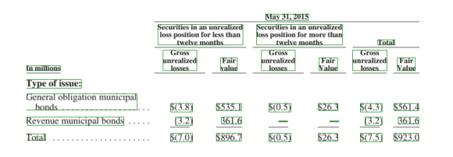
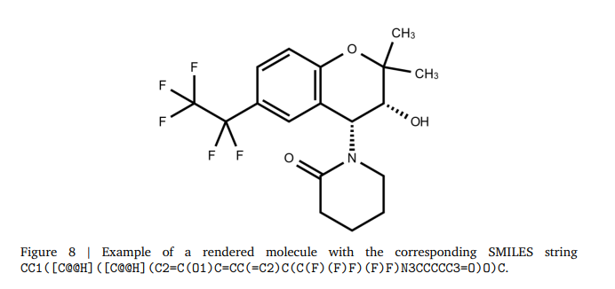
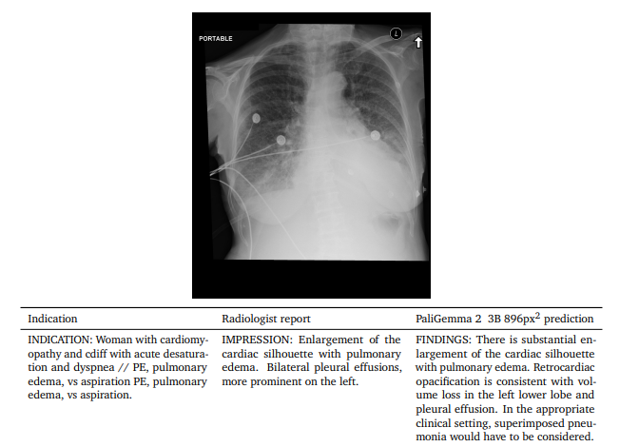
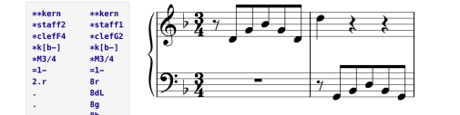
PaliGemma 2
Table Structure Recognition
Chemical Molecular Structure Recognition
Radiography Detection
Music Score Recognition

Slide 25
Resources

Slide 26
Resources
Vision Language Models: https://huggingface.co/blog/vlms
Gemma official documentation: https://ai.google.dev/gemma/
PaliGemma official documentation: https://ai.google.dev/gemma/docs/paligemma
PaliGemma 2: https://developers.googleblog.com/en/introducing-paligemma-2-powerful-vision-language-models-simple-fine-tuning/
Gemma Cookbook: https://github.com/google-gemini/gemma-cookbook
Hugging Face Spaces by Big Vision: https://huggingface.co/spaces/big-vision/paligemma
Get started with inferencing PaliGemma with examples: https://github.com/NSTiwari/PaliGemma

Slide 27





Thank You.
linkedin.com/in/tiwari-nitin
medium.com/@tiwarinitin1999
twitter.com/@NSTiwari21
github.com/NSTiwari

